Slide 1

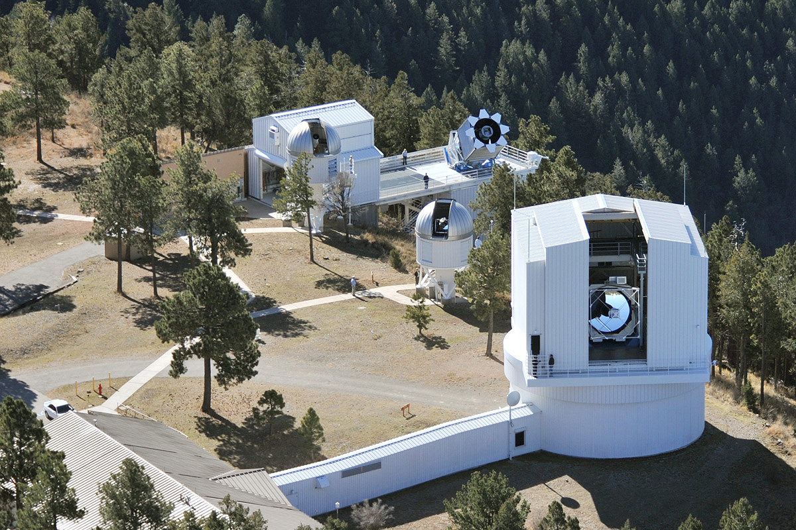
OU & APO
John Wisniewski
Department of Physics & Astronomy
University of Oklahoma
APO 20th Anniversary

Slide 2
What Makes APO Special?
People
  Strong leaders
  Professional & knowledgeable TOs
  Professional & knowledgeable staff
  Professional & knowledgeable colleagues at member institutes
Instrumentation suite
  Especially ability for intra-night changes
Operations
  Stable, user-friendly remote obs software
  Flexible scheduling

Slide 3
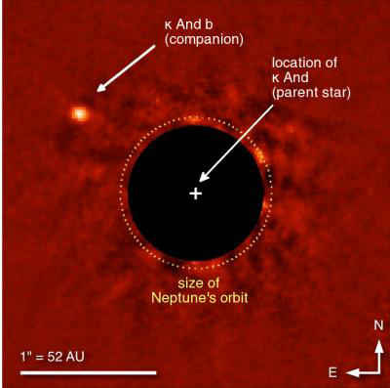
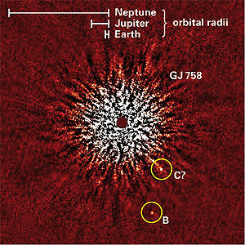
Science Highlights: Exoplanets
SEEDS (echelle)
  Fundamental stellar parameters of host (B9) star to kappa And b
  Likely very low mass (~>10 MJup) BD
  Bonnefoy et al 2014, A&A, 562, 111
  Age diagnostic for GJ 758 b, ~30-40 MJup BD
  Janson et al 2011, ApJ, 728, 85
  Age, activity, and fundamental stellar parameters for majority of SEEDS target sample
  “Moving Group” 3-yr summary paper
    Brandt et al 2014, ApJ, 786, 1
  Full sample, OU grad Evan Rich et al. in prep

Slide 4
Science Highlights: Exoplanets
SDSS-III/MARVELS follow-up (echelle)
  Constrain fundamental stellar parameters
  RV confirmation of BD candidate(s)
  8 refereed papers
SDSS-III/APOGEE follow-up (echelle)
  RV confirmation & stellar activity measurements
  Work in prep
Implications of dM Flares on the Characterization of Exoplanets at IR Wavelengths (arcsat)
  Flares on dM3e stars with energies that should occur 1x per 18 hr produce < 8.5 mmag response in H
  Flares on dM4.5e stars with energies that should occur 1x per 10 hr produce < 8.8 mmag response in H
  Tofflemire et al (2012) ApJ, 143, 12

Slide 5
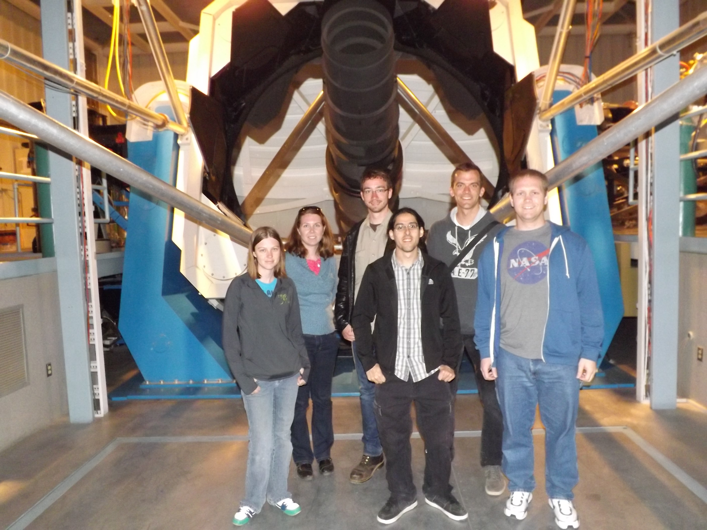
OU & APO: Student Training
OU: 7 astro faculty + 1 (2015; Nate Kaib) + 1 soon
  5 astro post-docs
  18 astro grads
2014-Q2 (3.5m+0.5m)
  6 students
2015
  Obs techniques class
  NHS (0.5m); OU-astro-101

Slide 6
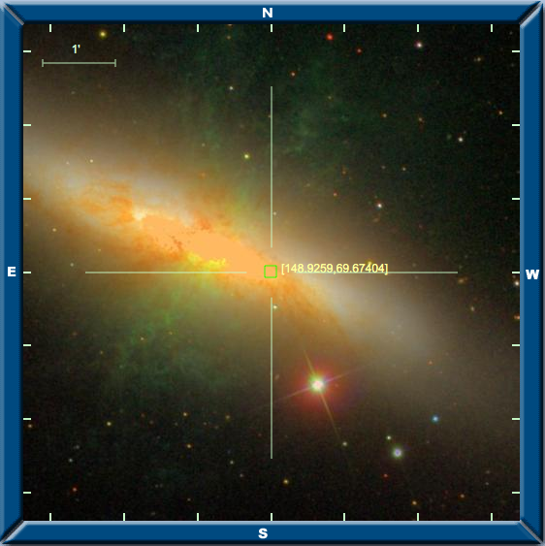
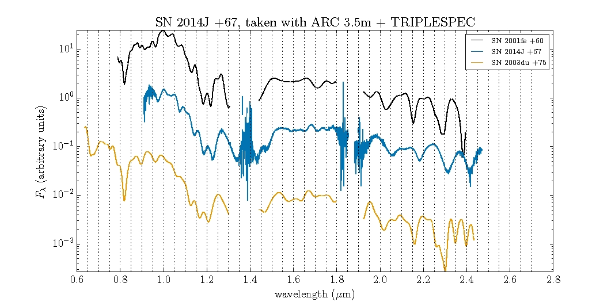
OU & APO: SN 2014J
M82 SN-Ia
  Discovered mid-Jan 2014
  Tspec obs April 8, 11 2014
Friesen et al 2014, in prep

Slide 7
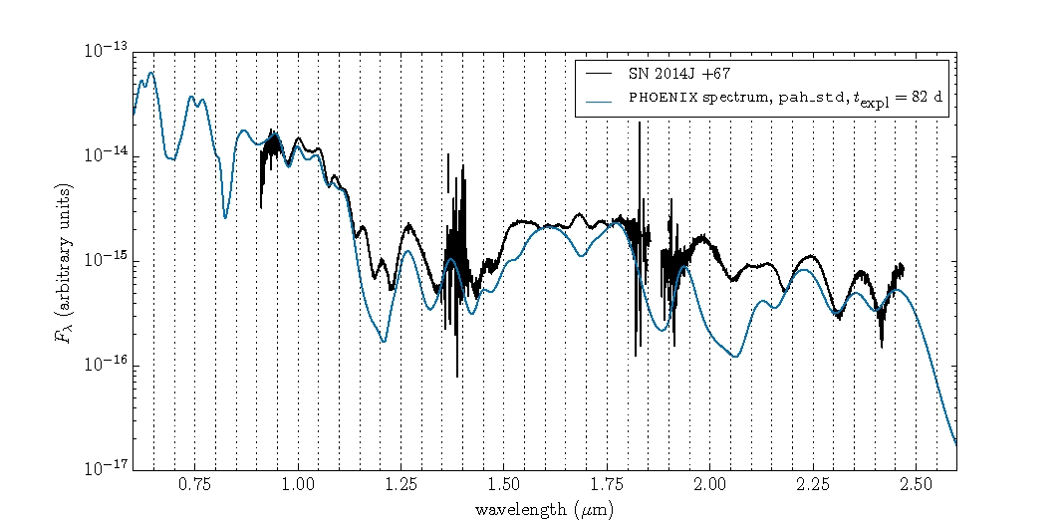
OU & APO: SN 2014J
Tspec epoch: transition from photospheric to nebular phase
  Currently being modeled w/ PHOENIX code
  Most features reproduced by permitted lines of Fe II, Co II, Ni II, Mn II, Ca II (& 1 [Ni II] line)
Friesen et al 2014,
in prep

Slide 8
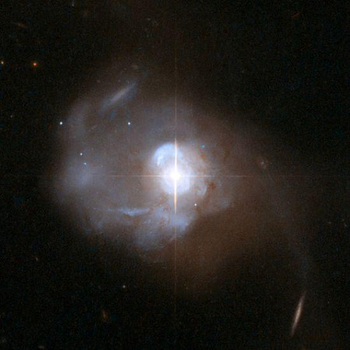
Mrk 231
A famous, nearby (z=0.0421) ultraluminous infrared galaxy
Nuclear starburst
Galactic outflow
Unique NaID broad absorption line

Slide 9
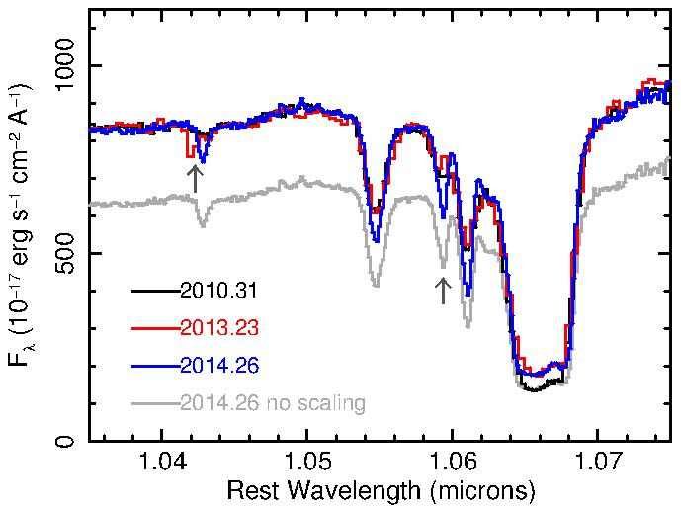
Discovery of HeI* Broad Line in Mrk 231
Leighly et al. 2014 discovered a HeI* Broad Line in 2010 IRTF data
2013 MDM data revealed tentative evidence for a new high-velocity component (~11,000 km/s)
2014 APO TripleSpec observation confirmed high velocity component.
TripleSpec resolution revealed additional component at 6,620 km/s.

Slide 10
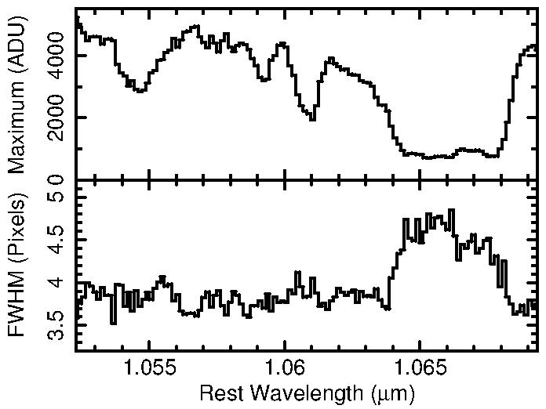
Origin of Trough Fill-in
HeI*10830 trough is not black, but is probably saturated. What is the origin of the fill in?
Analysis of high SNR spectral trace revealed resolved emission in the trough, implying host galaxy fill in.

Slide 11
Summary
OU is using the 3.5 + 0.5m for
  Variety of science: exoplanets, circumstellar disks, SN, pulsating WDs, quasars
  Student (grad+ugrad) training
    0.5m additionally for EPO and class labs
We hope to continue + expand our relationship with ARC in the future

Slide 12
More NaI Absorption Line Quasars?
Leighly et al. 2014 showed that the NaI absorption in Mrk 231 plausibly occurs in an interaction, along our line of sight, between the quasar wind and effluent from the nuclear starburst.
Is this interaction rare? Only 4 quasars with NaI absorption are known.
Or is NaI (5890, 5896Å) usually redshifted into the infrared?

Slide 13
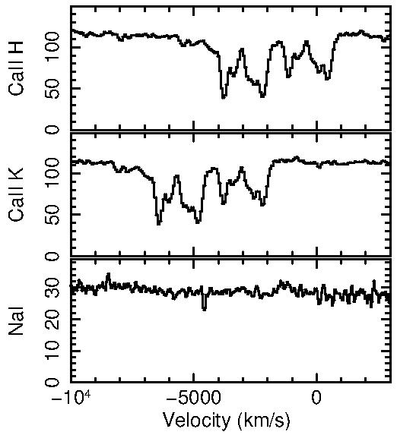
Search for Broad Na I Absorption in BALQSOs
First target: SDSS J0300+0048
Overlapping trough quasar with FeII, MgII, CaII absorption
Observed using APO TripleSpec Jan 27, 2014
No evidence for NaI absorption

